Slide 1
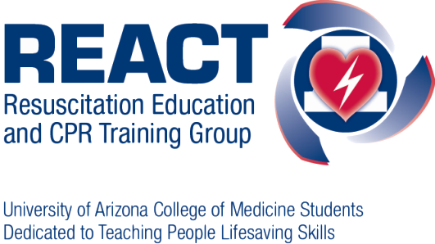
Chest Compression Only CPR
Save your Breath…
Save a Life
Notes:
1
Welcome slide

Slide 2
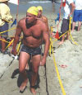
Sudden Cardiac Arrest — Any Age, Anybody & you’re likely to know the person
Chris Miller, at age 15, Erika Yee, a band mate who learned compression-only CPR in Girl Scout Camp, saves his life. Russell Vossbrink, at age 36, a crime lab investigator is saved by a co-worker. Rafael “Ralphie” Rendon, at age 14, collapsed during high school football practice. A volunteer coach responded. Brian Duffield, at age 41, collapsed after a swimming workout. A paramedic was nearby.
Notes:
All of these victims of cardiac arrest are alive today because someone around them knew how to respond.

Slide 3
Causes of Death (U.S.)
Sudden Cardiac Arrest
Heart disease kills more people each year than cancer
1 in every 2.9 of all deaths
Every year 230,000 - 325,000 people have a cardiac arrest outside of a hospital.
Only 7.6% will survive
Heart Disease
26%
All other causes
19%
Cancer
23%
Stroke
6%
Lloyd-Jones D, et al. American Heart Association Statistics Committee and Stroke Statistics Subcommittee. Heart disease and stroke statistics--2009 update: a report from the American Heart Association Statistics Committee and Stroke Statistics Subcommittee. Circulation. 2009 Jan 27;119(3):e21-181.
Notes:
Lloyd-Jones D, Adams R, Carnethon M, De Simone G, Ferguson TB, Flegal K, Ford E, Furie K, Go A, Greenlund K, Haase N, Hailpern S, Ho M, Howard V, Kissela B, Kittner S, Lackland D, Lisabeth L, Marelli A, McDermott M, Meigs J, Mozaffarian D, Nichol G, O'Donnell C, Roger V, Rosamond W, Sacco R, Sorlie P, Stafford R, Steinberger J, Thom T, Wasserthiel-Smoller S, Wong N, Wylie-Rosett J, Hong Y; American Heart Association Statistics Committee and Stroke Statistics Subcommittee. Heart disease and stroke statistics--2009 update: a report from the American Heart Association Statistics Committee and Stroke Statistics Subcommittee. Circulation. 2009 Jan 27;119(3):e21-181.

Slide 4
Cardiac Arrest: Fact vs. Fiction
Stereotype
Reality
Gender
Male
Male and Female
Age
Old
Any Age
Risk Factors
Overweight Smoker
High cholesterol
No Known
Risk Factors
Medical
History
Often No
Cardiac History
Heart Attack
Presenting
Symptoms
Chest Pain
Dizziness
Often No
Symptoms
Notes:
What are the things the public usually thinks of as being related to heart problems?
While these factors do increase your risk for heart disease, cardiac arrest is different in that it can affect anyone.

Slide 5
Heart Attack vs Cardiac Arrest
Heart Attack:
Cardiac Arrest:
Blockage in coronary artery
Person usually conscious
Upper body discomfort or pain
Heart stops
Person is unconscious
Often no previous symptoms
Person may be gasping or not be breathing at all
Often a cardiac arrest occurs due to a heart attack. Call 911
Notes:
2 types of heart problems the public is familiar with: heart attack and cardiac arrest.
Talk about how they should always call 911, not try to take someone to the ED themselves.
Often a cardiac arrest occurs due to a heart attack.

Slide 6
Primary vs Secondary Cardiac Arrest
Heart stops pumping
Blood in arteries full of oxygen
Often unexpected witnessed collapse
Secondary CA
Heart stops pumping due to lack of oxygen
Drowning, Drug Overdose or Choking
Primary CA

Slide 7
Out-of-Hospital Cardiac Arrest
Approximately 70-80% of all adult cardiac arrest are a primary cardiac arrest.
Chest Compression Only CPR
Ann Emerg Med. 1997 Jul;30(1):69-75.
Notes:
70-80 percent

Slide 8
What is Chest Compression Only CPR?
A new method of resuscitation developed through extensive research at The University of Arizona Sarver Heart Center for primary cardiac arrest
Continuous forceful chest compressions to circulate the person’s blood to their brain and heart
Rescue breathing isn’t necessary.
Notes:
8

Slide 9
Why isn’t Rescue Breathing Necessary?
During Primary Cardiac Arrest:
Lungs are full of air
Blood is full of oxygen
Circulating the oxygenated blood is the key
Notes:
EXPLAIN EMS ADDAGE

Slide 10
Why Might “Rescue Breathing” be Harmful?
Any interruption of chest compressions stops blood flow to the brain
Increased pressure in the chest decreases blood return to the heart

Slide 11
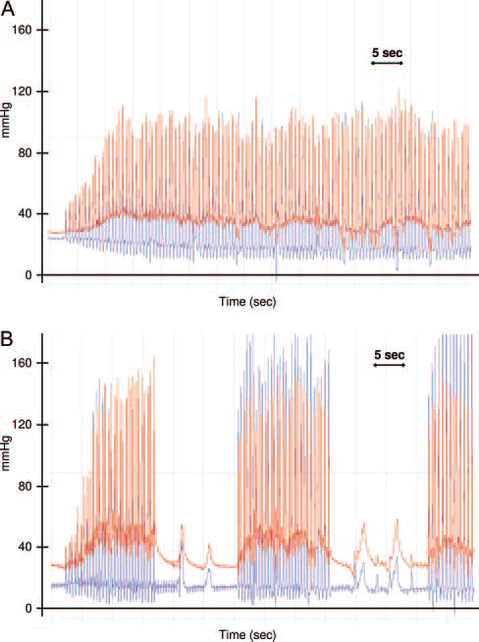
Chest Compressions Only
Blood Flowing
To The Brain
Compressions + Breaths (30:2)
Pausing for
breaths means
No Blood Flow
Blood Flowing
To The Brain
Ewy GA, et al. Circulation. 2007;116(22):2525-30.
Notes:
This is a graph that shows that every time you stop chest compressions, blood is no longer flowing to the brain.

Slide 12
Why Chest Compression Only CPR?
It saves more lives
Dramatically better than doing nothing.
Because of interruption of chest compressions, also does better than traditional CPR.
Bobrow, et al. JAMA October 2010

Slide 13
What Stops People from Doing CPR?
Fear / Concern
Solution
Mouth-to-Mouth
Harming the Person
Legal Consequences
Won’t Perform Properly
Physically Unable
Chest Compressions Only (with masks during COVID-19 era)
Better than dead
Good Samaritan Law
Easier to Do
Do Your Best / Call For Help
Coons SJ, et al. Resuscitation 80;334-340:2009
This study was designed and funded by the Sarver Heart Center
The University of Arizona College of Medicine and SHARE

Slide 14
Bystander CPR in Arizona (2005 to 2010) Witnessed Primary Cardiac Arrest
40%
30%
25%
20%
15%
10%
5%
0%
34%
Survival to Hospital Discharge
18%
18%
No
CPR
Traditional
CPR
CCO CPR
Rates are for ventricular fibrillation; from Bobrow, et al. JAMA October 2010
Notes:
Only shockable, witnessed patient’s

Slide 15
When to use Chest Compression Only CPR?
Chest Compression
Only CPR
Traditional CPR (30:2)
Someone who unexpectedly collapses, and is unresponsive.
Obvious Breathing Problems:
Drowning
Choking
Drug overdoses
Children less than 8
Vast Majority
When in doubt, do compressions!!
Notes:
If found down not witnessed, do compressions. You can tell the story of the garbage truck driver who saw someone down on his route and saved a life.
Must explain the 30:2 for traditional CPR for breathing problems and children less than 8. The reasoning for it is that these groups of individuals clearly
benefit from this type of CPR. Children less than 8 generally go down due to a respiratory issue vs. cardiac.
For choking, Heimlich is first performed if person is still responsive, but once he/she becomes unresponsive traditional CPR needs to be performed.

Slide 16
What to do: 3 Cs–
Check
Shake & Shout
Are You Alright?
Call 911
Send Someone for an A.E.D.
(if available)
Compress Chest at 100 Per Minute
Notes:
16

Slide 17
How to Do Chest Compression Only CPR
With the victim on the floor:
Kneel beside them
Place the heel of one hand on top of the other
3. Lock your elbows
4. Aim for the middle of the chest (on the sternum between the nipples)
Push hard and fast (try for 100/min.)
Take turns with another person when tired.
Notes:
17
With the victim on the floor:
1. Kneel beside them
2. Place one hand on top of the other
3. Lock your elbows
4. Aim for the middle of the chest (on the sternum between the nipples)
5. Push as hard and fast (try for 100/min.) as you can.
DEMONSTRATE

Slide 18
CCO-CPR in the COVID-19 Era
Most likely you will know the victim – 70% of cases.
If you need to help a stranger:
Mask Up – wear a mask in public
If the victim isn’t wearing a mask, use their shirt to cover their face.
Practice at home – Place a couch cushion on the floor to practice in place of a mannequin.

Slide 19
Chest Compressions: Rate and Depth
At least
100 Compressions per Minute
At least
2 inches in depth
Allows the heart to refill
Staying Alive or
I Gotta Feeling by Black Eyed Peas
After each compression, take all weight off the chest
Notes:
The exact optimal compression rate is unknown, but one of the biggest concerns seen in the field is pushing too slowly and without enough force. Therefore, if a question is brought up – we are shooting for around 100 compressions and 2 inches and the error should be on the side of faster and more depth.

Slide 20
Are They Breathing?
Gasping is a sign of cardiac arrest
Majority of people with cardiac arrest gasp
Can be a sign of minimal, but adequate blood flow to the brain.
DO NOT stop chest compressions if they gasp
Notes:
911 will ask if person is breathing, this used to be a hurdle to initiating compressions.
If you listen to the room, we are all breathing but you don’t hear anything, so gasping is not “normal breathing.”
One way this phenomenon was discovered was when a woman was on the phone with dispatch about resuscitating her husband, she asked “Why is it that every time I push on his chest he starts to gasp, but when I stop doing compressions he goes back into a coma?”

Slide 21
Automatic External Defibrillators (AEDs)
Notes:
21

Slide 22
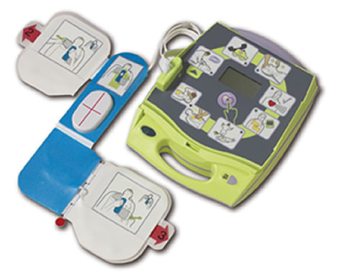
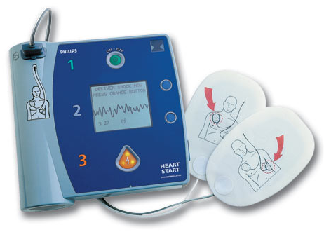
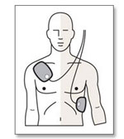
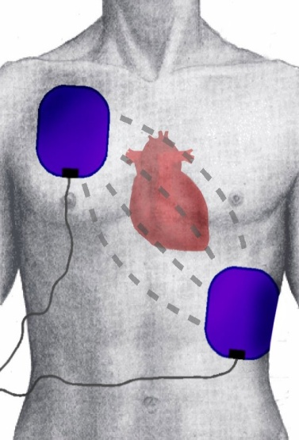
AEDs
They may look different, but they all function the Same!
Open and Follow Instructions
Turn AED ON
Apply Pads to Bare Chest
Plug in Pads (if necessary)
Analyze Patient (CLEAR!)
Push Shock to defibrillate, if directed (CLEAR!)
Immediately resume CPR
Notes:
If the AED tells you to breathe for the person but you are trained in CCO, it is okay to just keep doing chest compressions.
The unit will reanalyze the person’s heart rhythm after 2 minutes.

Slide 23
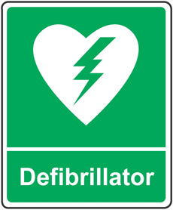
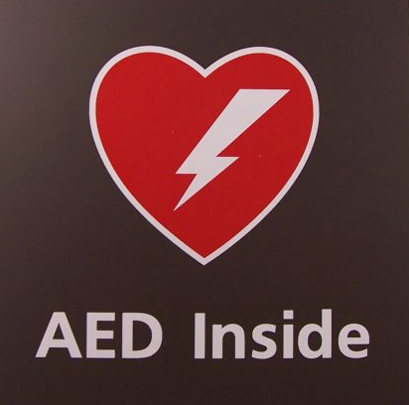
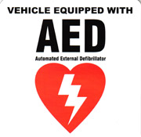
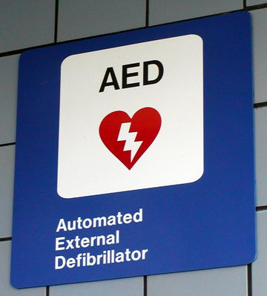
The Universal Symbol
Safe
Easy
Voice Prompted

Slide 24
What to do: 3 Cs–
Check
Shake & Shout
Are You Alright?
Call 911 & Send Someone for an A.E.D.
Compress Chest at 100 Per Minute
Use an A.E.D. When it Arrives
Notes:
24
Make sure to mention that using the AED as soon as it arrives is critical.
Someone can still be performing chest compressions while another person is getting the AED set up.

Slide 26
Thank You
Save your Breath…
Save a Life
Notes:
26

Slide 27
How to Do Chest Compression Only CPR
With the victim on the floor:
Kneel beside them
Place one hand on top of the other
3. Lock your elbows
4. Aim for the middle of the chest (on the sternum between the nipples)
Push hard and fast (try for 100/min.)
Take turns with another person when tired.
Notes:
27
With the victim on the floor:
1. Kneel beside them
2. Place one hand on top of the other
3. Lock your elbows
4. Aim for the middle of the chest (on the sternum between the nipples)
5. Push as hard and fast (try for 100/min.) as you can.
DEMONSTRATE

Slide 28
Appendix
Notes:
28

Slide 29
Bystander CCO CPR Improves Chance of Survival from Cardiac Arrest
100%
80%
60%
40%
20%
0%
CCO CPR
Traditional CPR
Survival (%)
No CPR
EMS Arrival
0 1 2 3 4 5 6 7 8 9
Time between collapse and defibrillation (min)
Nagao, K Current Opinions in Critical Care 2009
EMS Arrival Time based on TFD 90% Code 3 Response in FY2008. Standards of Response Coverage 2008.
Notes:
7% to 10% each minute in patients receiving no CPR
3% to 4% each minute in patients receiving Traditional CPR
2% each minute in patients receiving chest compression-only CCR
*This is a good slide to answer the question: “If I know there is an AED somewhere in the vicinity and I am alone, should I start chest compressions or go get the AED?”

Slide 30
Three-Phase Model of Resuscitation
100
Myocardial ATP
Percent
0
Electrical
Circulatory
Metabolic
Phase
Phase
Phase
0
2
4
6
8
10
12
14
16
18
20
Arrest Time (min)
Weisfeldt ML, Becker LB. JAMA 2002: 288:3035-8

Slide 31
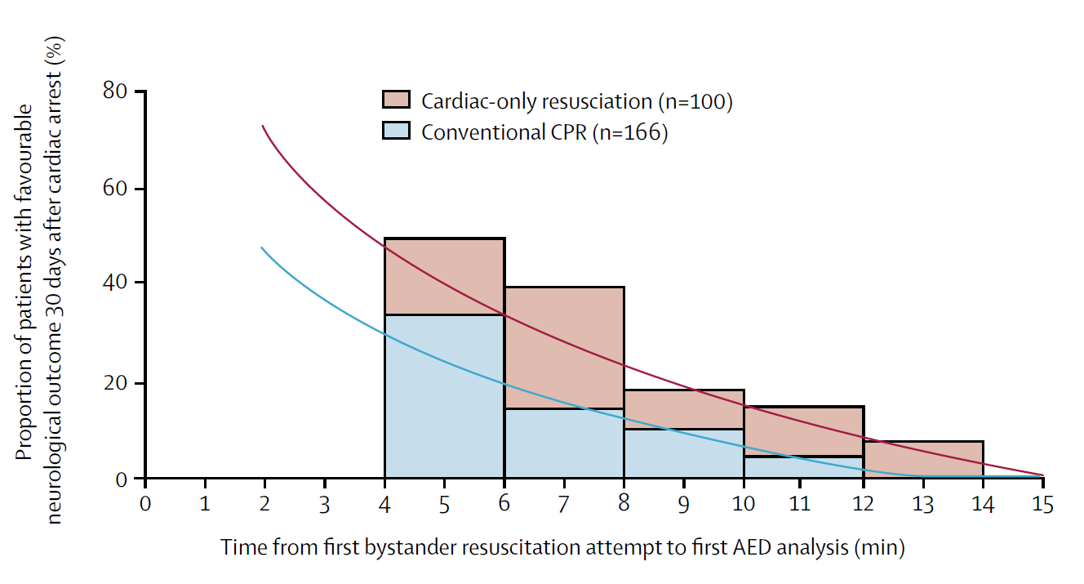
SOS-Kanto study group. Cardiopulmonary resuscitation by bystanders with chest compression only (SOS-KANTO): an observational study. Lancet. 2007;369:920-6.
Notes:
31

Slide 32
Bystander CPR in Arizona (2005 to 2010) All out-of-hospital cardiac arrests
25%
20%
15%
10%
5%
0%
Survival to Hospital Discharge
113/849
52/666
13.3%
150/2,900
7.8%
5.2%
No
CPR
Traditional
CPR
CCO
CPR
Rates are for all cardiac arrests; from Bobrow, et al. JAMA October 2010

Slide 33
FAST for Stroke if people ask about stroke
Face –Does one side droop? Smile?
Arms – Raise arms? Is one weak or numb?
Speech – Slurred? Repeat a simple sentence?
Time – Have symptoms? Call 911! Get to hospital immediately!

